Slide 1




Adaptive Web Design

Slide 2
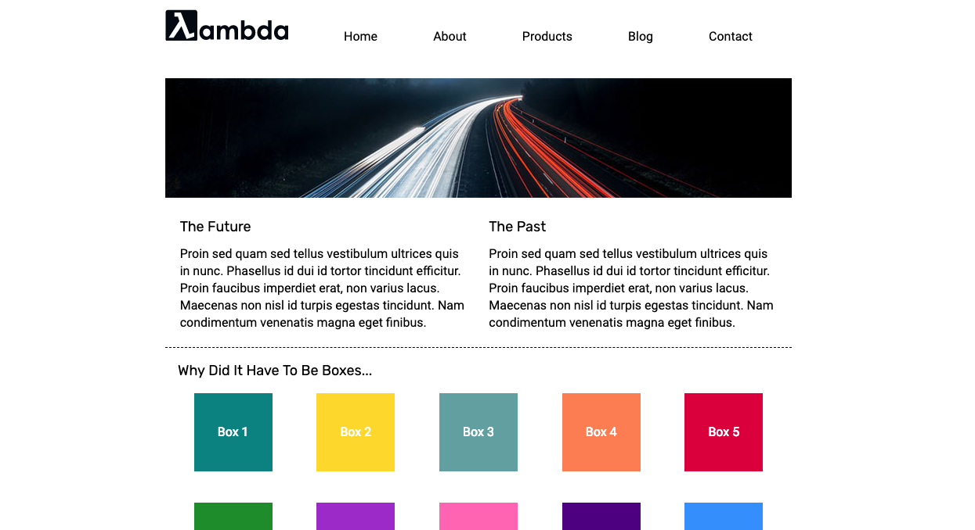

Multi-Page Website

Slide 3

Exploring CSS Fundamentals

Slide 4


Slide 5
Notes:
Adaptive Web Design

Slide 6
Notes:
Multi-Page Website

Slide 7



Notes:
#JavascriptFundamentals

Slide 8


Notes:
React + Higher Order Components

Slide 9



Notes:
React + Higher Order Components

Slide 10
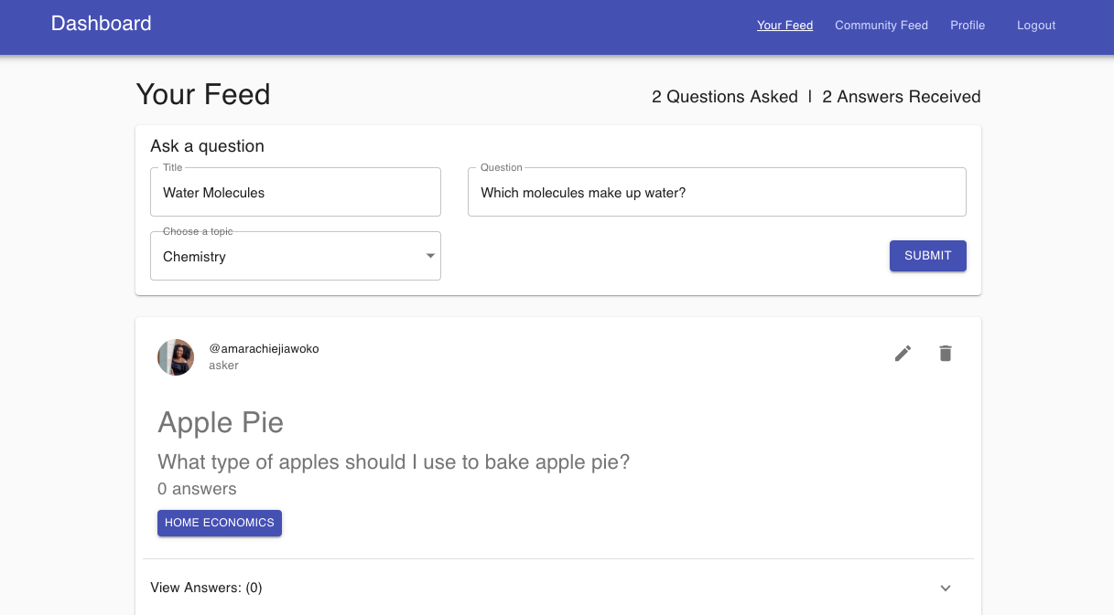
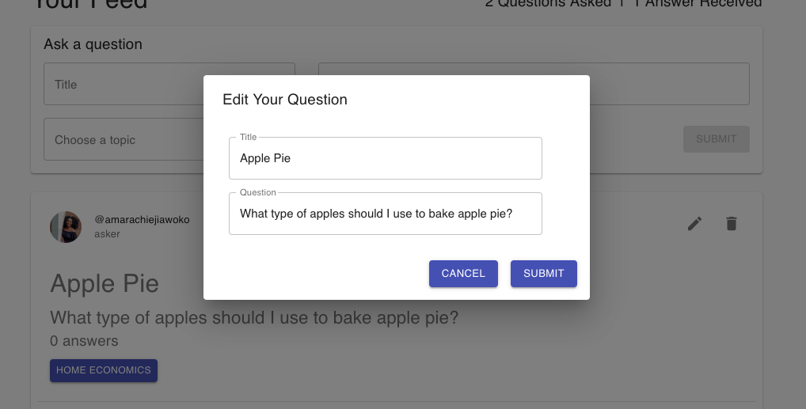
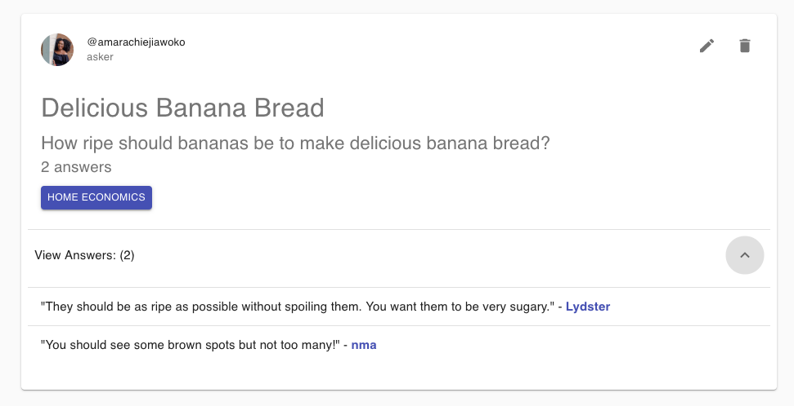
Notes:
React + Higher Order Components

Slide 11
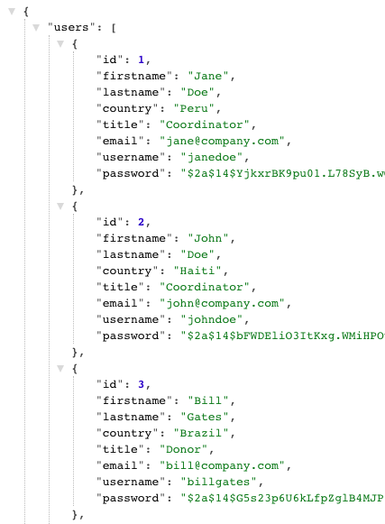
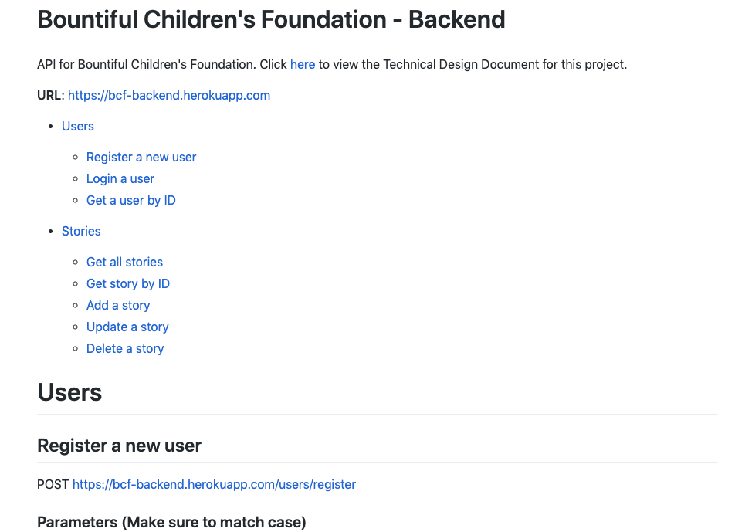
Notes:
React + Higher Order Components

Slide 12

Multi-Page Website

